Slide 1
Video Generation with GAN
Michael Mathieu, Camille Couprie, Yann LeCun, Deep multi-scale video prediction beyond mean square error, ICLR, 2016
Pac-Man: https://github.com/dyelax/Adversarial_Video_Generation
UCF101: http://cs.nyu.edu/~mathieu/iclr2016extra.html

Slide 2
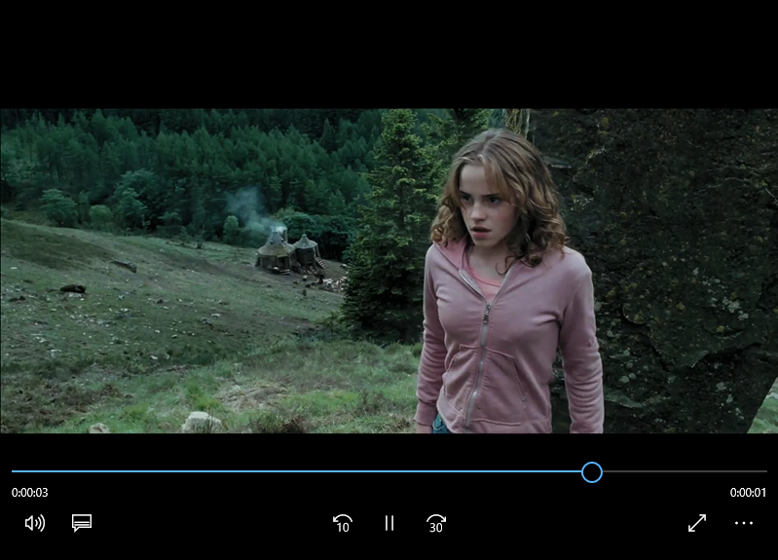
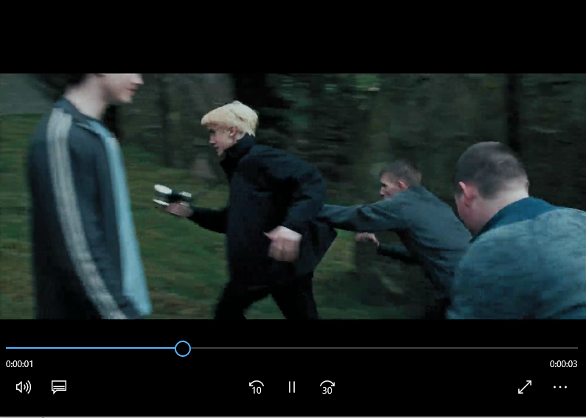
Video Generation
target
Minimize distance
Generator
Discriminator thinks it is real
Discrimi
nator
Last frame is real or generated
Notes:
Conditional version

Slide 5
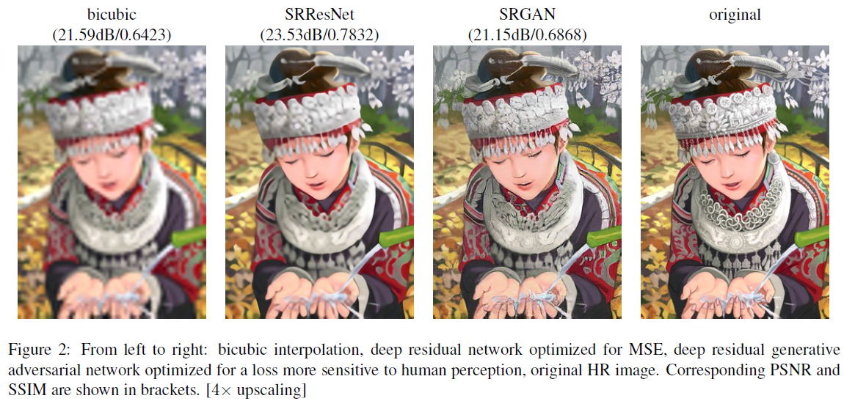
Besides Video Generation ……
Image super resolution
Christian Ledig, Lucas Theis, Ferenc Huszar, Jose Caballero, Andrew Cunningham, Alejandro Acosta, Andrew Aitken, Alykhan Tejani, Johannes Totz, Zehan Wang, Wenzhe Shi, “Photo-Realistic Single Image Super-Resolution Using a Generative Adversarial Network”, CVPR, 2016

Slide 6
Besides Video Generation ……
Speech synthesis
Takuhiro Kaneko, Hirokazu Kameoka, Nobukatsu Hojo, Yusuke Ijima, Kaoru Hiramatsu, Kunio Kashino, “Generative Adversarial Network-based Postfiltering for Statistical Parametric Speech Synthesis”, ICASSP 2017
Yuki Saito, Shinnosuke Takamichi, and Hiroshi Saruwatari, "Training algorithm to deceive anti-spoofing verification for DNN-based speech synthesis, ”, ICASSP 2017

